Slide 1

A Training Report On “Pizza Sales Analysis” Submitted to the Rajasthan Technical University, Kota in partial fulfillment of the requirement for the degree of MASTER OF COMPUTER APPLICATION
Submitted to: Submitted by: Mr. Sunil Chauhan Rahul M Ramchandani
MCA 22CMSXX643
Department of Computer Science and Application
Maharishi Arvind Institute of Science & Management
Rajasthan Technical University, Kota
Session: 2022 - 2024

Slide 2
Pizza Sales - A Data Analytics Project

Slide 3
CONTENTS
01 Introduction
02 Why we chose this topic?
03 Data Overview
04 Insights

Slide 4
Introduction
“keep your friends close, and your pizza closer.”
We all love pizzas—it's a universal favorite! As avid pizza enthusiasts, we wondered how beneficial it would be for pizza makers to understand their fans' demands through data. This inspired us to analyze pizza sales data, providing valuable insights into best-selling pizzas and category preferences. These insights can help pizza businesses refine their offerings, optimize operations, and better satisfy their customers, ultimately driving their success.

Slide 5
Why we chose this topic?
As passionate pizza enthusiasts, we pondered how impactful it would be for pizza makers to have detailed insights into their customers' preferences and demands. This led us to the idea of analyzing pizza sales data to provide invaluable knowledge to pizza businesses.
By delving into this data, we aim to offer pizza makers a comprehensive understanding of their best-selling pizzas and the preferences across different categories. These insights will empower them to refine their offerings, optimize operations, and better satisfy their customers.

Slide 6
Data Overview
To kick start our analysis, We first delved into the dataset, which provided thorough information about pizza orders, including the total price, quantity sold, order date, pizza name, size, and category. Total Revenue: We calculated the total Revenue, providing an overview of our earnings.
Total Pizza Sold: This metric revealed the number of pizzas sold.
Total Orders: It gave us count of distinct orders, providing insights into our order volume.
Average Order: The middle order amount helped us understand the spending patterns of customers.

Slide 7
Discovering Top and Bottom Performers: We identified the top and bottom five pizza names by the number of orders, which shed light on customer preferences.
Analyzing Top and Bottom Performers by Quantity: We uncovered the top and bottom five pizza names by the quantity sold, revealing which pizzas were the most & least popular.
Exploring Sales by Pizza Size and Category: We determined which pizza sizes and categories were most sold, providing valuable insights for optimizing inventory.
Understanding Sales Trends: We analyzed daily and monthly sales trends, spotting patterns in customer ordering behavior.
Percentage Sales by Pizza Category and Size: We calculated the percentage of sales for each pizza category & size, offering insights into the performance of our products.

Slide 8

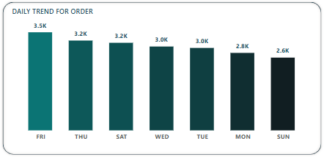
Daily Trend for Orders

Slide 9
Insights for daily trend
The data shows that Sundays have the lowest number of orders with a total of 2,624 orders. The reasons why Sundays have the lowest orders and other weekdays have more orders are:
Routine and Eating Habits: During weekdays, people are often busier with work or school and may prefer ordering food rather than cooking. Sundays are typically more relaxed, and families might prefer home-cooked meals or dining out.
Weekend Activities: On Sundays, people may engage in various activities such as attending church, spending time outdoors, or visiting friends and family, which might reduce the likelihood of ordering food.
Office Orders: Many offices and workplaces order pizza for lunch meetings, team gatherings, or Friday treats, contributing to higher weekday sales.
Friday Socializing: Friday often marks the beginning of the weekend, and people may celebrate by ordering pizza, leading to a spike in orders.
Meal Planning: By Sunday, individuals may be preparing for the week ahead, engaging in meal prepping or grocery shopping, which can lower the demand for takeout.

Slide 10
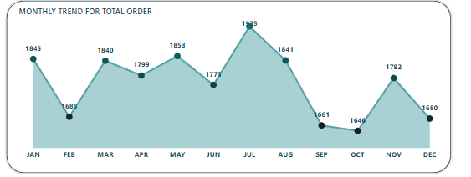
Monthly Trend for Total Order for 2022

Slide 11
Insights for monthly trend
The data shows that July has the highest number of orders with a total of 1,935 orders. These are the main reasons to understand why July has the maximum number of orders -
Seasonal Demand: July is a summer month, and people tend to order more food during holidays and vacations. The increase in leisure activities and gatherings might contribute to higher pizza sales.
School Holidays: Many schools have summer vacations in July, leading to increased family activities and higher demand for convenient food options like pizza.
Tourism Season: July is a peak travel month, with more tourists and visitors who might prefer ordering in rather than cooking, boosting pizza sales.
Marketing Campaigns: Companies may strategically plan major marketing campaigns and promotions during the summer to attract more customers, including new product launches or limited-time offers.

Slide 12
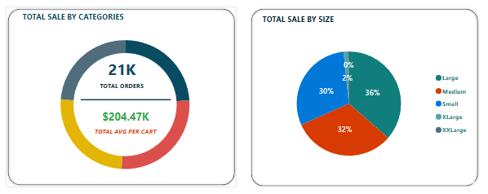
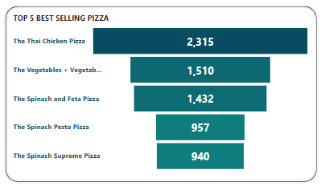

Slide 13
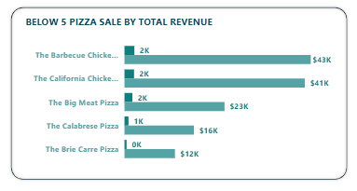

Slide 14
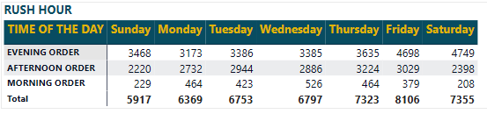
Rush Hour Order

Slide 15
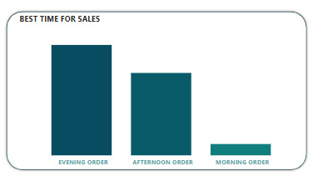

Slide 16
Insights and Recommendations
They have sold a total of 50,000. pizzas. This data can guide inventory and production planning.
The average order amount is $38, indicating the customers’ spending habits. This could inform pricing and promotions.
The Classic Deluxe Pizza are customer favorites, and they should consider marketing them more prominently.
The Classic Deluxe Pizza are top performers in terms of quantity, showing strong demand.
Large Size and Classic dominate sales, suggesting they should prioritize these sizes and categories.

Slide 17
Technology used
To gain valuable insights from our pizza sales data, we leveraged three powerful tools:
Power BI, SQL, and MS Excel. Each tool played a critical role in our analysis, enabling us to efficiently handle, analyze, and visualize our data.
By integrating SQL, MS Excel, and Power BI, we created a powerful workflow that enabled us to extract, clean, analyze, and visualize our pizza sales data effectively. This combination allowed us to gain deep insights into customer preferences and sales trends, ultimately helping us to make informed decisions to drive business growth.

Slide 18
viva la pizza
Thank you

